Slide 1
Final Year Research Project Descriptors School of Electrical & Electronic Engineering School of Mechanical & Materials Engineering
Assessment Integrity in the Era of Large Language Models: Threats and Opportunities within the UCD College of Engineering & Architecture
June 2023

Slide 2
FYP Module Descriptors
How are FYP project modules’ assessment components described on the course search website?
Are all FYPs the same (produce a long document (thesis/dissertation), produce an interim report, deliver an interim presentation, deliver a final presentation, final interview)?
If so, should there be some homogeneity as to how these are described?

Slide 3
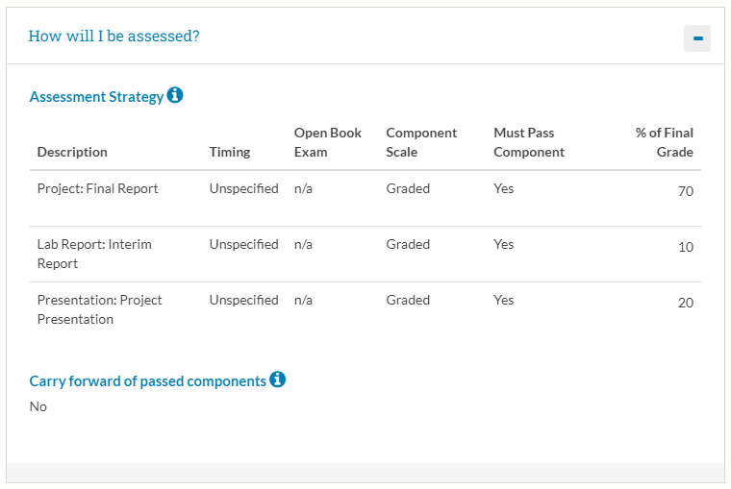
ME Biomedical Engineering

Slide 4
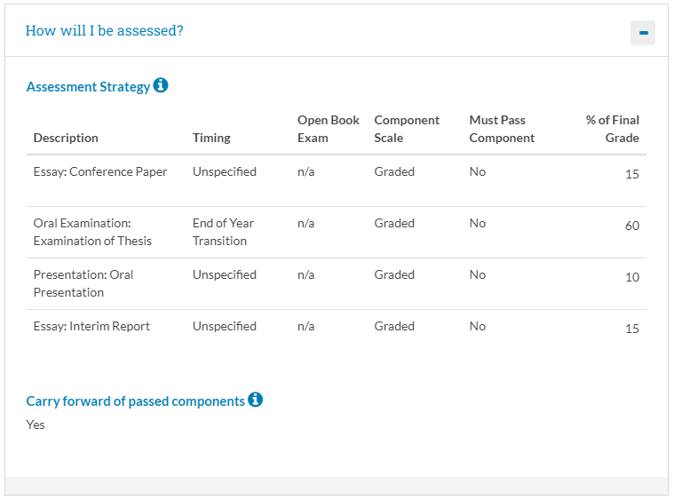
ME Electronic & Computer Engineering

Slide 5
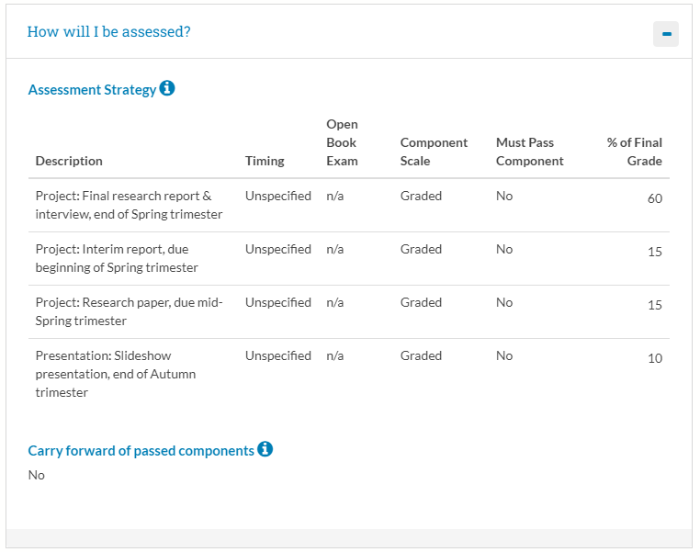
ME Electrical Power Engineering

Slide 6
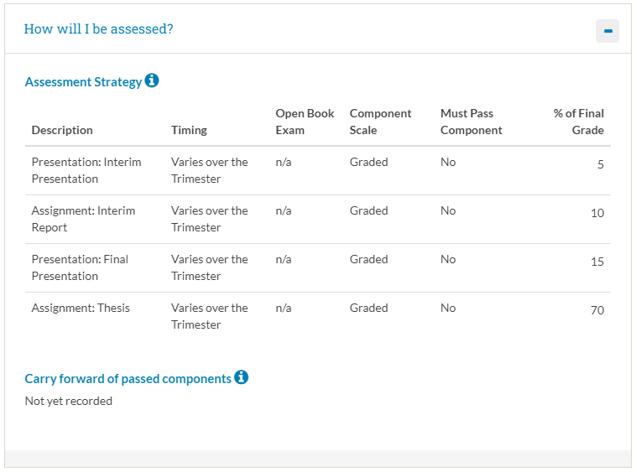
ME Mechanical Engineering

Slide 7
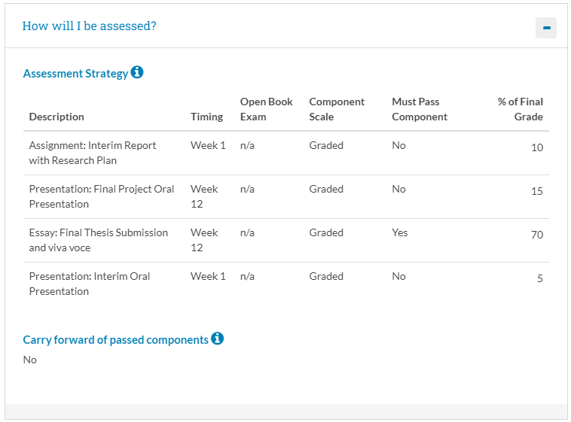
ME Materials Science & Engineering

Slide 8
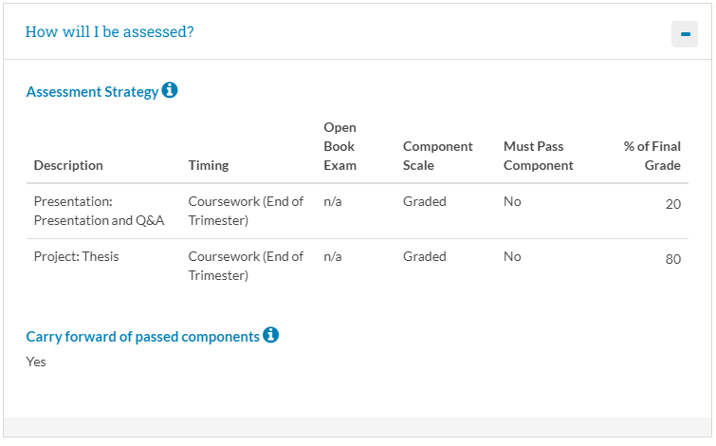
ME Engineering with Business

Slide 9
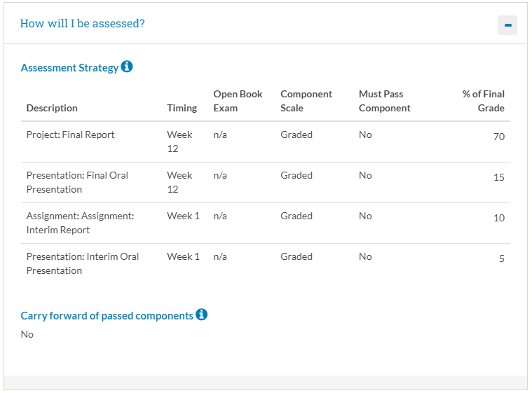
ME Energy Systems Engineering

